Slide 1
Data Analysis Project Presentation
Mohith Kumar Thummaluru - B180299CS
Rahul Kumawat - B180635CS
Tushar Kumar Patni - B180122CS
Avinash Samudrala - B180409CS
Ritik Gautam - B180630CS

Slide 2
Contents
Introduction
SO2 Monthly data set analysis across cities
Ward wise SO₂ levels
Choropleth maps
Regression for SO₂ levels
Multivariate Analysis
Conclusion
Ritik Gowtham

Slide 3
Introduction
Properties of SO₂
SO₂ one of the major pollutant.
SO₂ is a colorless, bad-smelling and toxic gas which is part of a larger group of chemicals.
Sources of SO₂
SO₂, is emitted by the burning of fossil fuels - coal, oil, and diesel etc.
Ritik Gowtham

Slide 4
Cont'd...
Effects of SO₂
SO₂ can contribute to respiratory illness by making breathing more difficult.
It combines with water vapour present in the atmosphere to form sulphuric acid that causes acid rain.
Ritik Gowtham

Slide 5
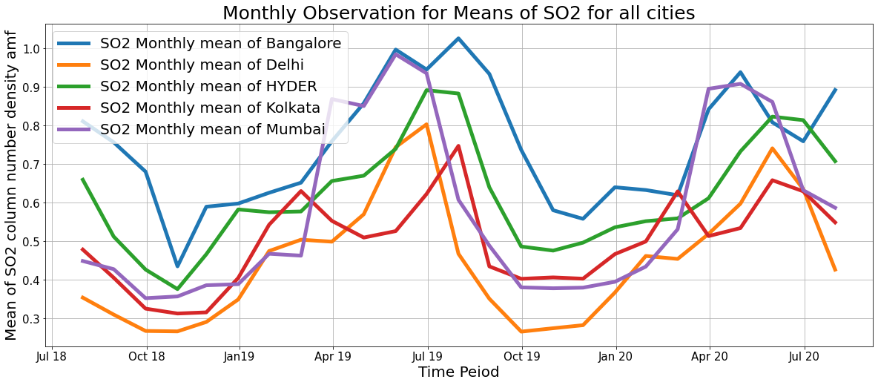
2. SO2 Monthly data set analysis across cities
2.1 Monthly Means
Mohith

Slide 6
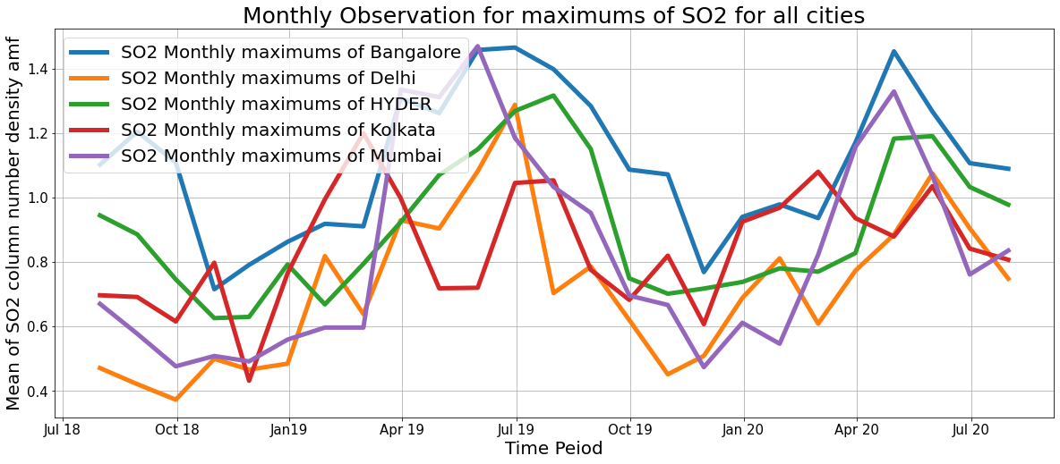
2.2 Monthly Maxs
Mohith

Slide 7
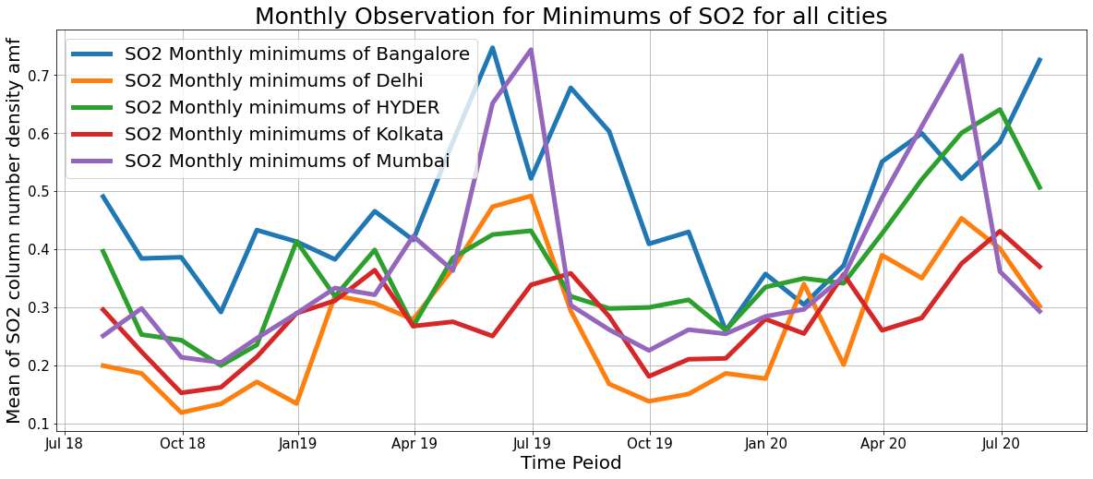
2.3 Monthly Mins
Avinash

Slide 8
2.4 Observations from the monthly data
Mean values of SO₂ are considerably high in summers than in monsoons and winters.
This is due to the fact that the rise in usage levels of air-conditioners and refrigerators which are the major sources of SO₂ .
A seasonal trend is observed in the levels of SO2.
Mohith , Avinash

Slide 9
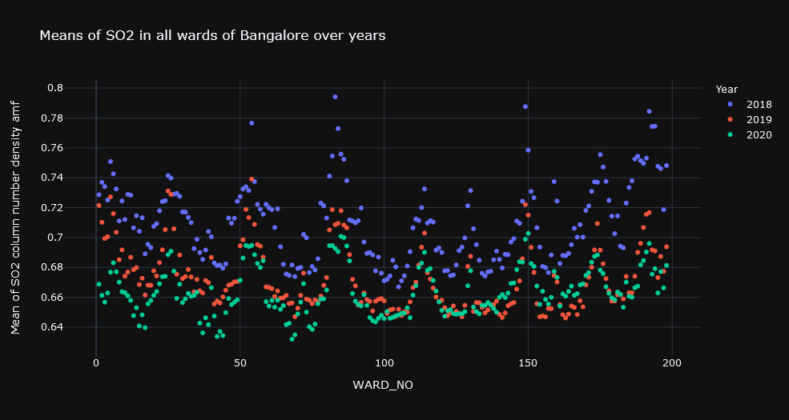
3. Ward Wise SO2 levels
3.1 Bangalore
count 594.000000
mean 0.682246
std 0.029667
min 0.631988
25% 0.658269
50% 0.676498
75% 0.699951
max 0.794131
Name: mean, dtype: float64
Mohith, Avinash

Slide 10
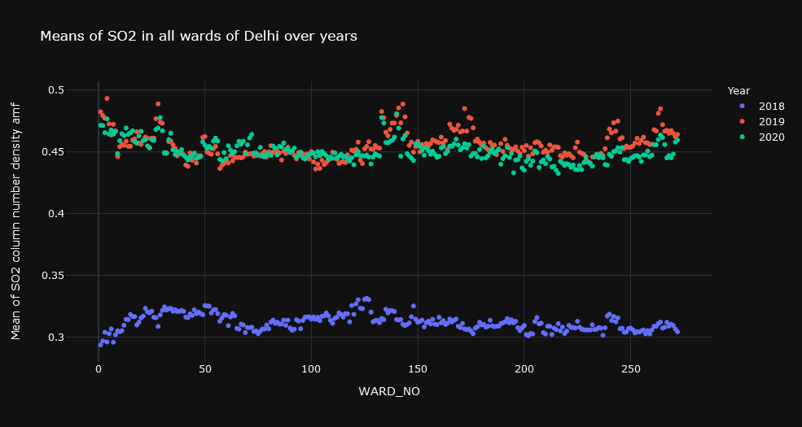
3.2 Delhi
count 867.000000
mean 0.406229
std 0.067197
min 0.293726
25% 0.316199
50% 0.446580
75% 0.454588
max 0.493260
Name: mean, dtype: float64
Mohith, Tushar

Slide 11
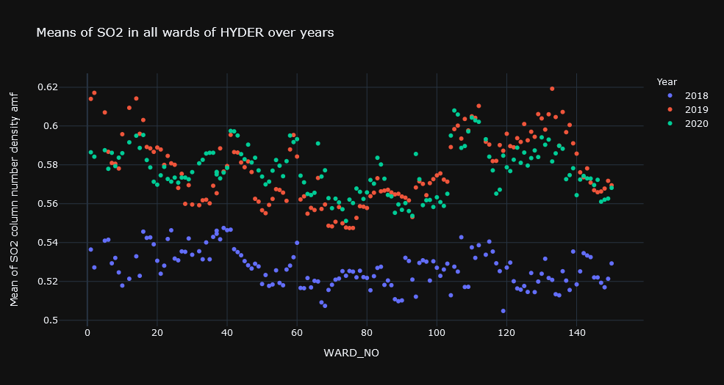
3.3 Hyderabad
count 435.000000
mean 0.560609
std 0.027464
min 0.504799
25% 0.532716
50% 0.565423
75% 0.582271
max 0.619198
Name: mean, dtype: float64
Mohith, Rahul

Slide 12
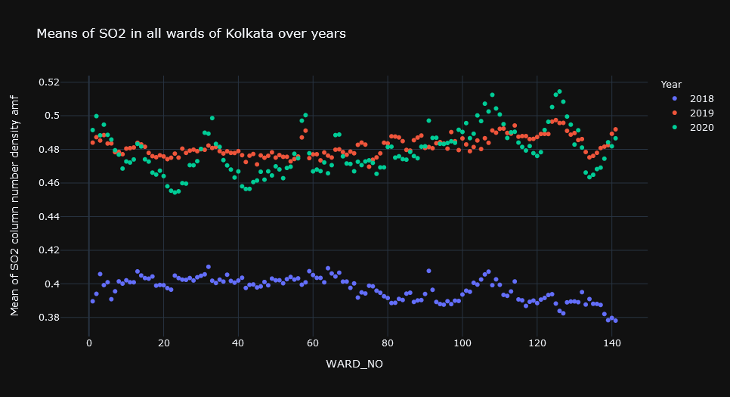
3.4 Kolkata
count 423.000000
mean 0.452581
std 0.040499
min 0.378095
25% 0.402414
50% 0.474470
75% 0.483084
max 0.514445
Name: mean, dtype: float64
Rahul, Tushar

Slide 13
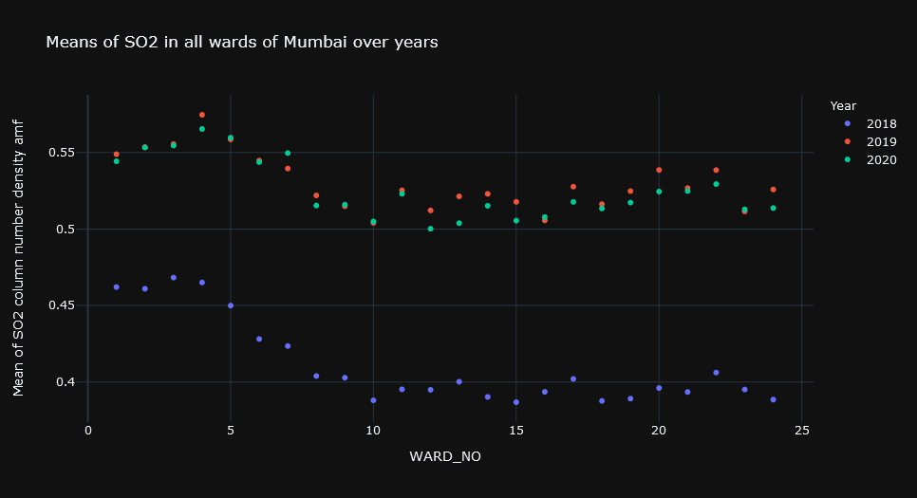
3.5 Mumbai
count 72.000000
mean 0.489176
std 0.059714
min 0.386803
25% 0.426950
50% 0.514331
75% 0.527027
max 0.574718
Name: mean, dtype: float64
Rahul, Tushar

Slide 14
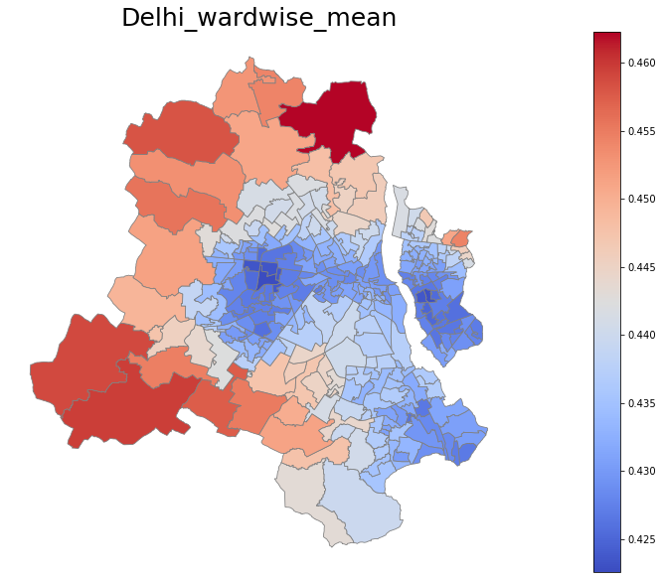
4. Choropleth Map:
Thematic map in which a set of predefined areas is colored in proportion to a statistical variable that represents an aggregate summary of a geographic characteristic within each area.
Here, statistical variable is SO2_column_number_density_amf and the areas are wards of respective cities.
Mohith , Avinash

Slide 15
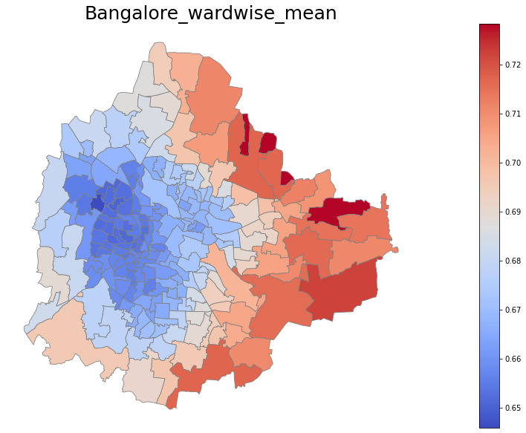
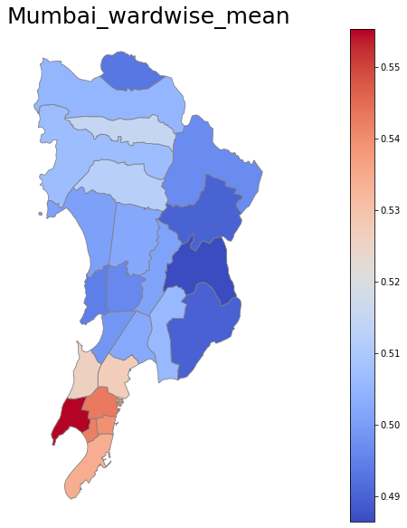
Avinash, Rahul

Slide 16
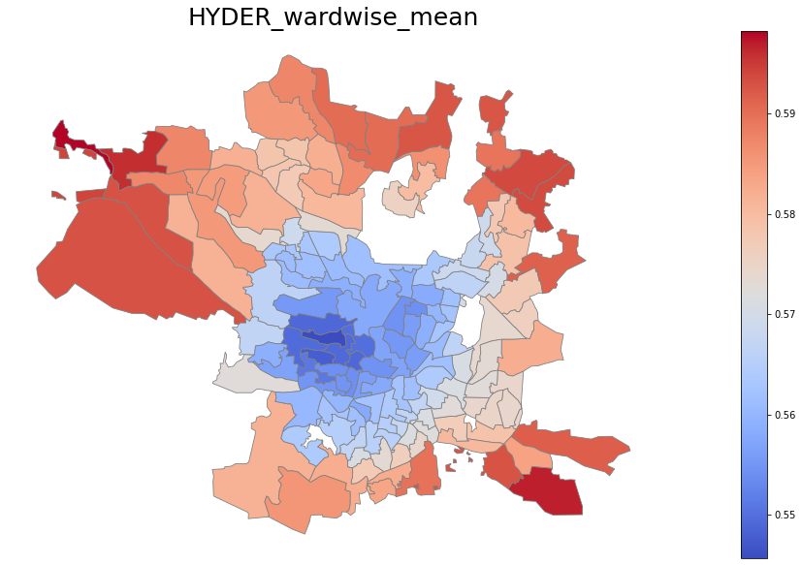
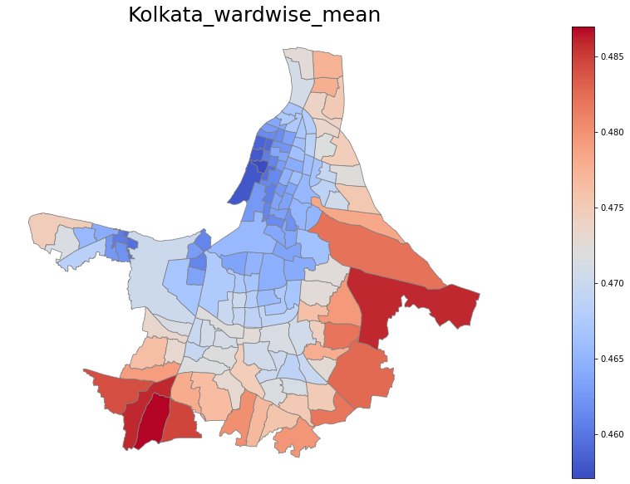
Avinash, Mohith

Slide 17
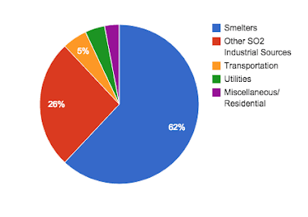
Inference from Choropleth maps:
Major sources of SO2 are smelters.
We can notice a considerable reduction in levels of SO2 in the center hubs of major cities over the past 2-3 years.
This is because people over there are getting aware of the effects of rising levels of SO2 and started inclining towards CNG which reduced the emissions of SO2 from automobiles in the cities.
So the levels of SO2 in the outskirts of cities, where the smelters are high in number, remained high.
Mohith , Avinash

Slide 18
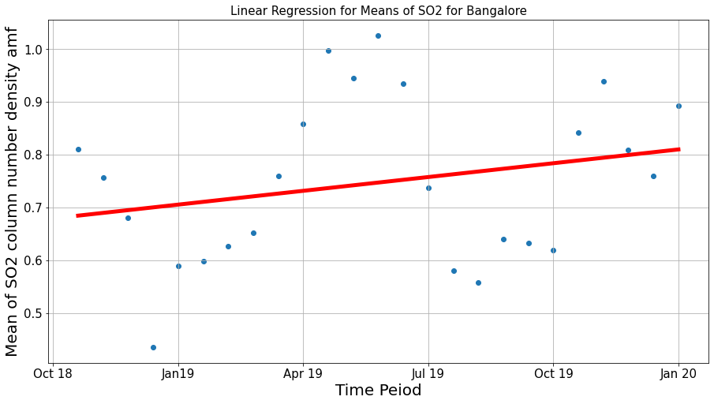
5. Regression of SO2
5.1 Bangalore
count 25.000000
mean 0.747157
std 0.155321
min 0.435046
25% 0.625875
50% 0.756830
75% 0.858075
max 1.026315
Name: mean, dtype: float64
Mohith, Avinash

Slide 19
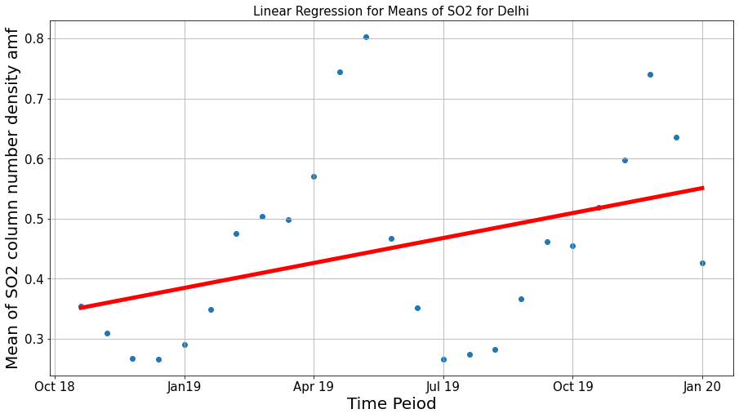
5.2 Delhi
count 25.000000
mean 0.451115
std 0.160634
min 0.265778
25% 0.309969
50% 0.454284
75% 0.519147
max 0.803422
Name: mean, dtype: float64
Mohith, Avinash

Slide 20
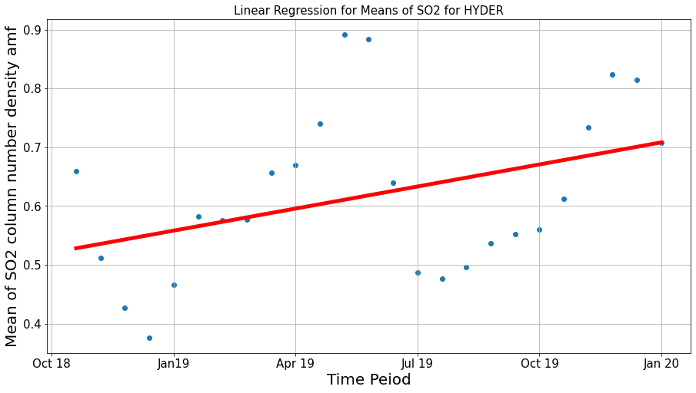
5.3 Hyderabad
count 25.000000
mean 0.618186
std 0.139840
min 0.376018
25% 0.512270
50% 0.582619
75% 0.707708
max 0.891944
Name: mean, dtype: float64
Mohith, Avinash

Slide 21
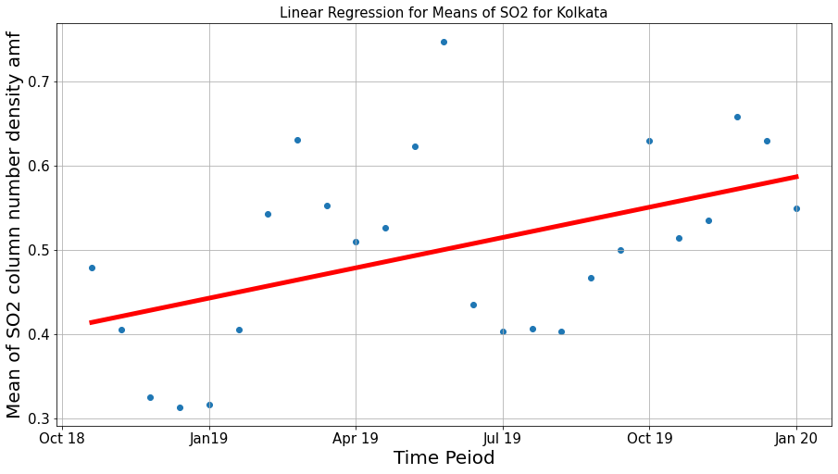
5.4 Kolkata
count 25.000000
mean 0.500126
std 0.114036
min 0.312725
25% 0.405568
50% 0.509696
75% 0.553012
max 0.747491
Name: mean, dtype: float64
Rahul, Tushar

Slide 22
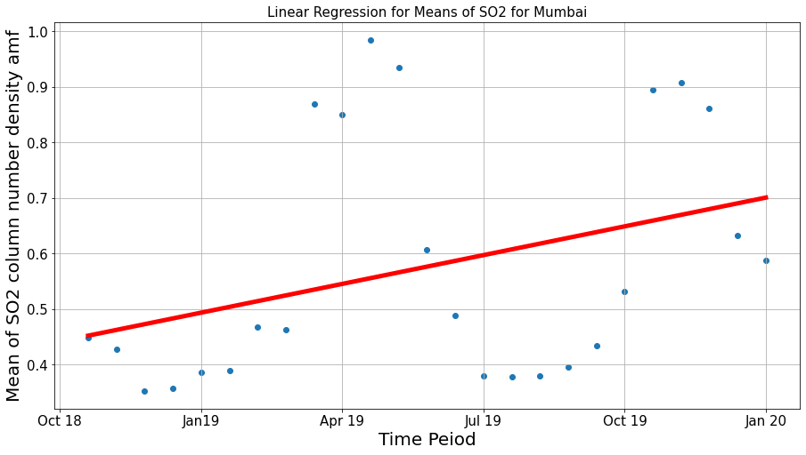
5.5 Mumbai
count 25.000000
mean 0.576477
std 0.220430
min 0.352493
25% 0.388811
50% 0.467718
75% 0.850701
max 0.984980
Name: mean, dtype: float64
Rahul, Tushar

Slide 23
5.6 Inferences from Regression analysis
Since the trends of SO₂ depends on various parameters, there is no concrete conclusion that can be drawn from the linear regression analysis.
But the noticeable observation that can be seen is that the levels of SO₂ had been rising over the years due to rise in usage of sources that emits SO₂.
Mohith, Avinash

Slide 24

6.Multivariate Analysis
Variables used:
Sentinel CO
Sentinel Pollution levels
Sentinel SO₂
Rahul, Tushar

Slide 25
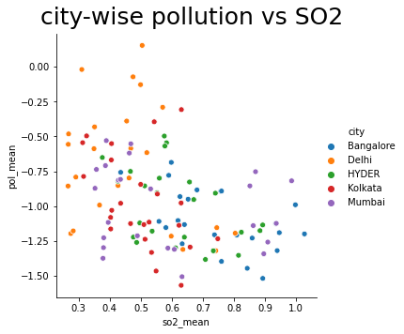
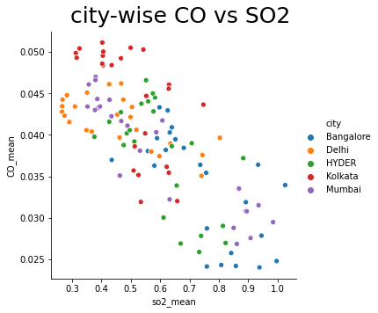
6.1 City-wise analysis of variables
Avinash, Tushar

Slide 26
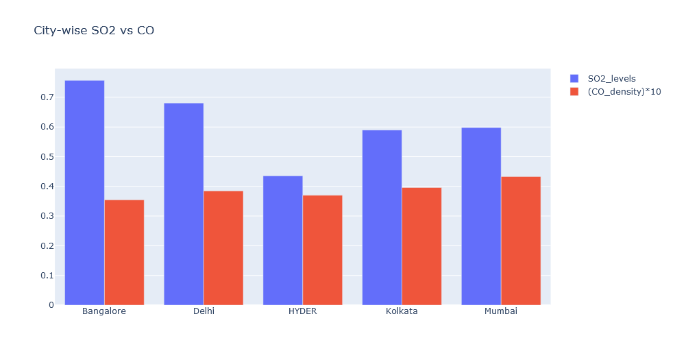
6.2 City-wise CO vs SO₂
Rahul, Tushar

Slide 27
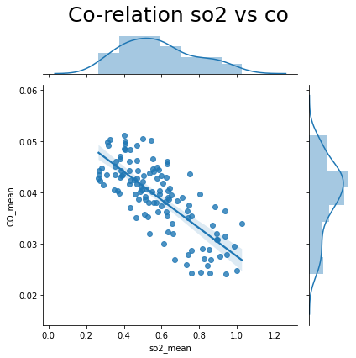
6.3 Correlation b/w SO₂ vs CO
Correlation coefficient
Corr ,_ = pearsonr(SO₂, CO) = -0.76
From this it can be inferred that SO₂ and CO are negatively strongly correlated.
Rahul, Avinash

Slide 28
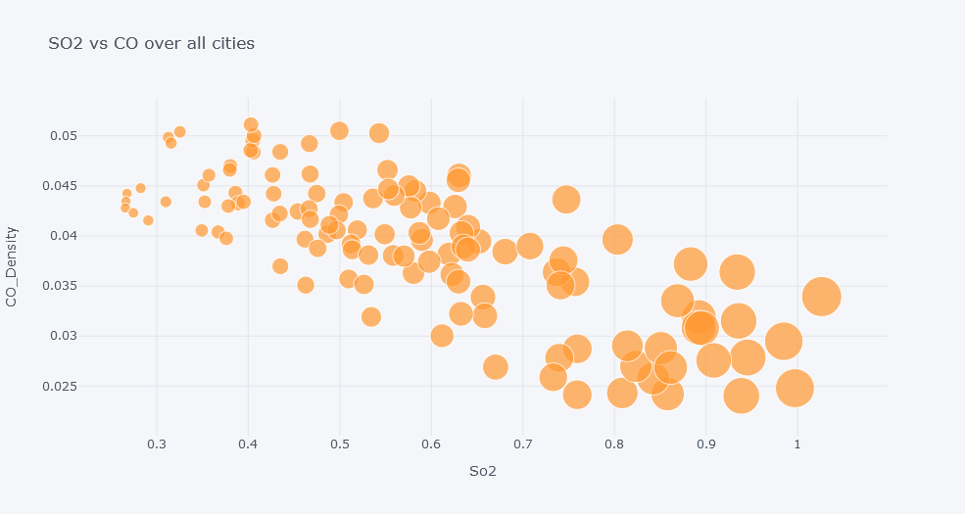
6.4 SO₂ vs CO over all cities
Avinash, Tushar

Slide 29
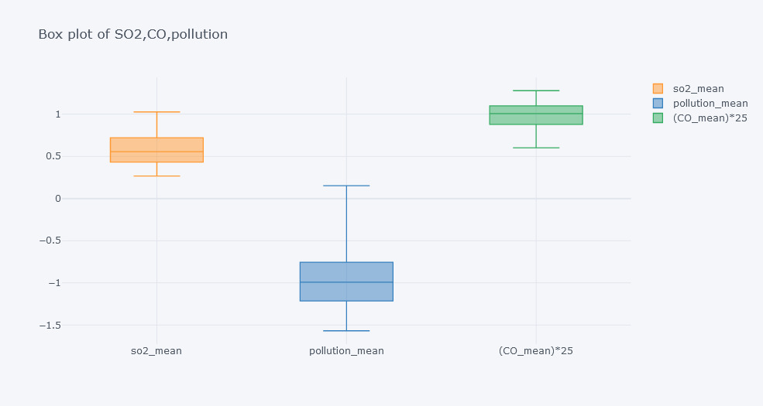
6.5 Box plot of SO₂, CO and Pollution
This is used to used to analyze the shape of the distribution, its central value, and its variability.
Tushar, Rahul

Slide 30
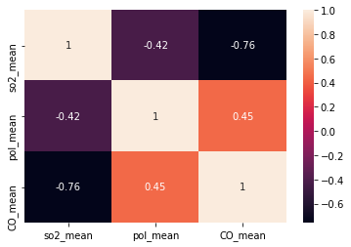
6.6 Heat Map
Here heat map is used to analyze the correlation coefficients across the variables.
It can be noticed that SO₂ mean values are strongly correlates with CO levels than pollution levels.
Mohith, Avinash

Slide 31
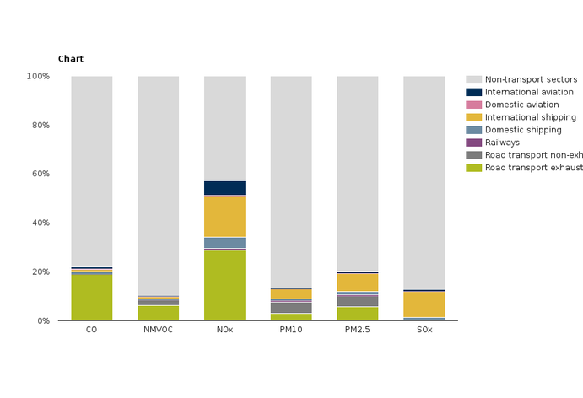
6.7 Inference from Heat Map
CO is strongly positively correlated with pollution than SO₂.
This is due to the fact that CO contributes more than Sulphur oxides for air pollution.
Rahul, Tushar

Slide 32
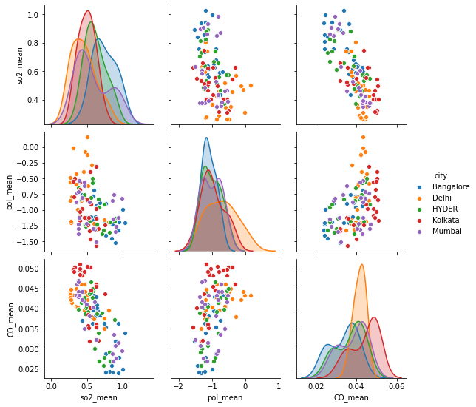
6.8 Pair Plot
We used Pair plot to plot the multiple pairwise bivariate distributions in our dataset.
Here analysis between SO₂ means, CO means and pollution means are done across all the major cities.
Avinash

Slide 33
7 Conclusion
Climate change is not a myth, it’s reality!!!
We analytically inferred that climate change trends are true.
Climate change is dependent on anthropogenic activities and also on urban areas that are heterogeneous environments composed of buildings and surfaces with different land patterns.
Mohith, Avinash

Slide 34
Cont'd...
Government should bring regulatory bodies to reduce the levels of SO₂ like
Monitoring coal-burning power plants sulphur emission activities.
By making powerplants to install scrubbers that remove SO₂ from gases leaving the smokestack.
By conducting awareness campaigns to educate people about the hazards of increase in levels of SO₂.
Avinash ,Mohith

